Slide 1
FloodCast Venice – Water you thinking? 💦
By: Muhammad Ali Ghanchi

Slide 2
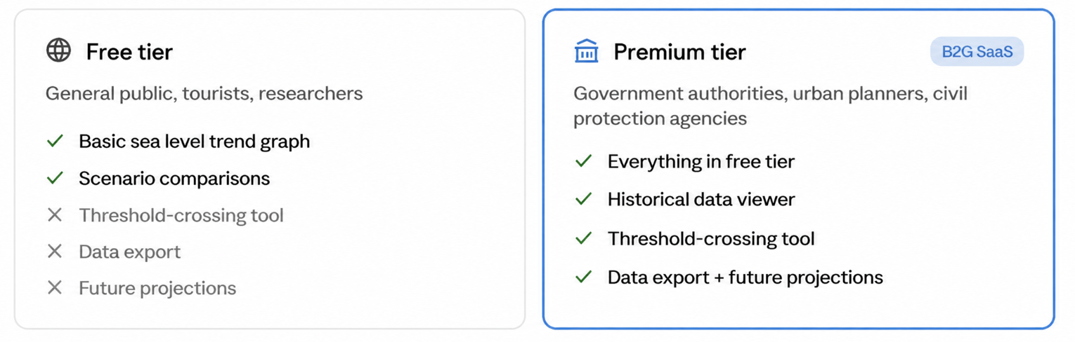
Business Case & Added Value
The problem:
Venice floods more than 200 times per year, yet most planning decisions still rely on static reports with no interactive scenario testing
Existing tools are either too technical for non-experts or too expensive for smaller municipalities
The product:
FloodCast Venice – Water you thinking? 💦 A web-based decision-support dashboard combining historical tide gauge data, climate-driven regression, and RCP scenario comparisons
Users set a critical flooding threshold and instantly see when each scenario crosses it, no data pipeline, no modelling expertise required

Slide 3
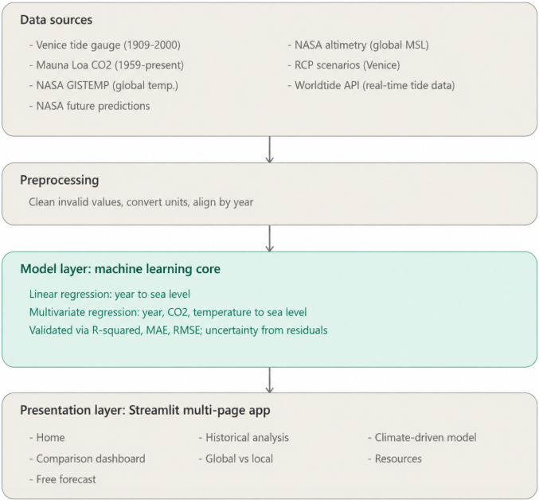
Architecture & Methodology
Methodology:
Development followed five stages: data collection, preprocessing, model training, prediction, and deployment
Why?
Linear regression suits long-term trend forecasting; it's simple, interpretable, and matches the scale of sea level data.

Slide 4
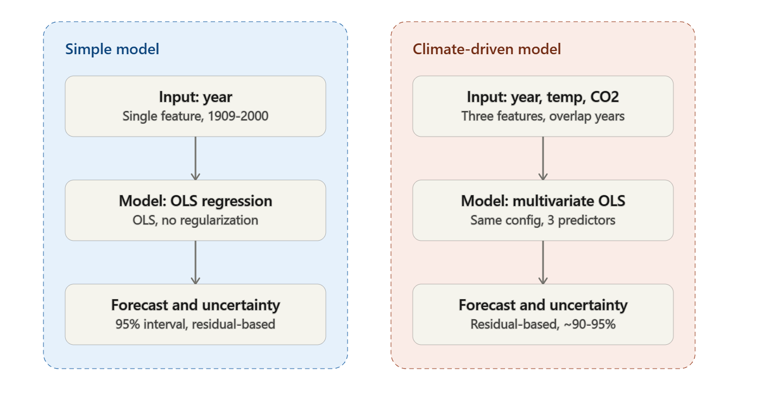
Technical Implementation & Configurations
Libraries:
  pandas + NumPy cleaning, merging 5 datasets on year
  scikit-learn Linear Regression two model variants (simple + climate-driven)
  Plotly interactive charts; Streamlit multi-page web app
  static curated datasets
Design decisions:
Switched matplotlib to Plotly for interactivity
Compared with future RCP predictions, used only for comparison
Built a Global vs Local page to isolate Venice's subsidence signal empirically
Integration of Wild Tide API.

Slide 5
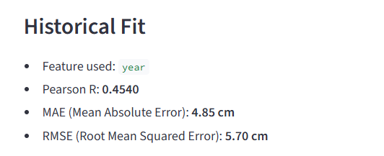
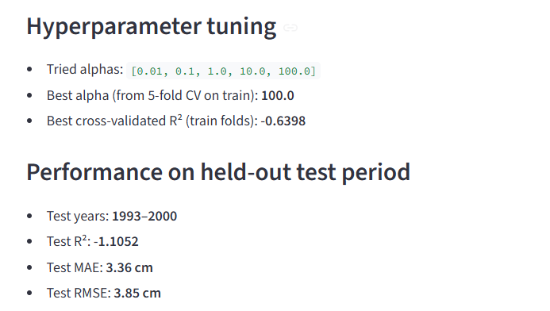
Results & Evaluation
Moderate correlation between year and sea level (R = 0.454).
Strong regularization selected (α = 100), favouring a simple model.
Negative test R² (-1.11) indicates poor generalization to unseen years.
Additional climate predictors are needed to improve forecasts.
Epoch curves are useful when you train a neural network or an SGD-based model with many passes over the data. I used classical linear/Ridge regression, which directly computes the best parameters without epoch-style training, so an epoch plot would be artificial and not informative

Slide 6
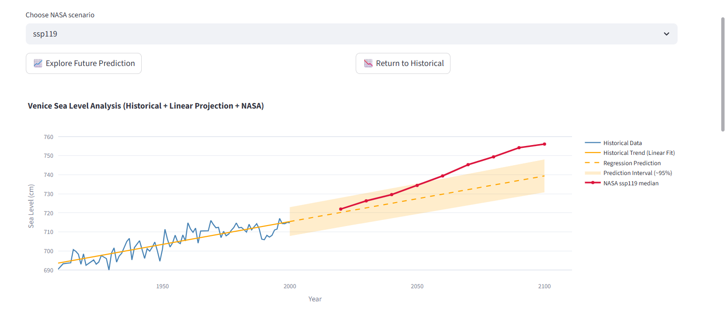
Goal Achievement & Digital Implementation
Goals met ✅
Users can pick a flooding threshold and the app tells them exactly which year Venice will reach it and under each climate scenario
Compared values with a viable source to confirm that the prediction is valid.
The app shows its working: all graphs, formulas, and accuracy metrics are visible to the user, nothing is hidden
Users just open the dashboard and get answers. No coding, no building models themselves. Data can also be downloaded directly as CSV
Partially met ⚠️
We can predict the overall direction sea level is heading over decades, but not the exact value for any specific year. Natural year-to-year variation makes that impossible with a straight line mode.

